Slide 1
Digital Captive Society
By Julia Kovrigin

Slide 2
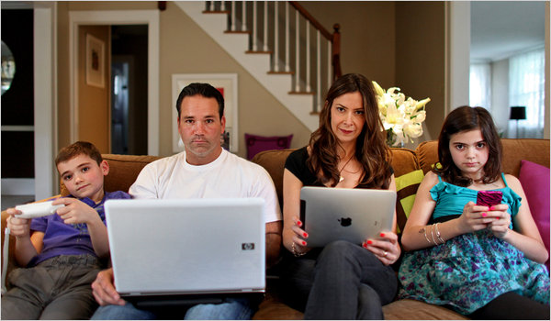
I have identified and researched three major points
that show the negative effects of technology on interpersonal communication.
This Photo by Unknown Author is licensed under CC BY-NC-ND
Notes:
With the proliferation of smartphones, apps, and internet-connected devices, there is a growing popular consensus that digital devices impact our society’s interpersonal communication in a negative way. Face-to-face communication is on decline because we choose to communicate through digital communication rather than interpersonal communication.
The purpose of this research paper is to identify the negative impacts that digital devices have on society’s interpersonal communication skills.
I chose this topic because I see people on their phones at restaurants and in coffee shops. They are glued to their screens, instead of being present in the conversation.
These changes have affected both the young and old: parents toss their kids a phone with a YouTube video to keep them occupied, and increasingly the social media habits of certain politicians regularly dominate the news cycle. I wanted to find out what research had to say about digital devices and communication.

Slide 3
the decline of face-to-face communication amongst friends and family
how the lack of face-to-face communication affects the workplace
how communication through digital devices negatively affects the younger generation, the future of our society
Notes:
Talk about why these three specific topics are important to me and the rest of the population.

Slide 4
Face-to-face communication amongst friends and family is degrading due to digital devices
the presence of a cellphone in face-to-face communication really affects the way a person’s relationships develops with whoever they are communicating with.
It's not only young adults that use their cellphones during family time. Children point out that their parents will miss out on important times during sporting events because they were on the phone.
The bond that is formed through face-to-face communication that gets lost in the digital space.
Emotional exchanges such as laughter, being sad when telling someone bad news, or apologizing will not translate in a text message or email the same way it does when you are face-to-face.
Notes:
Where I got the research :Iris Adler, the executive director for programming, podcasts and special projects at WBUR, a Boston NPR affiliate, wrote an article in which she points to research from JSPR
Adler interviewed Boston University student Ciera Wade, who stated that she would rather text than have face-to-face conversation. Ciera stated that it was easier for her to mask her feelings in a text. Ciera also said that she does not recall when she last spoke to her parents on the phone, she only text. If she is feeling sad, no one will know because they can’t see her or hear her on a text message. This also creates an issue for her socially because she gets nervous when she must have a face-to-face conversation (Adler, 2013). Wade is like many young people in that she would rather text then engage in an in person conversation.– tie this back to point number three.

Slide 5
Communication in the workplace is degrading due to digital devices just as it is between family and friends
Problems with face-to-face communication at work can negatively affect the ability of future and currents employees to meet each other’s needs
many employers are noticing that newer generations of employees are using email and texting instead of calling or communicating face-to-face. This hinders the ability for employees and managers to create a bond and a trust that is developed through face-to-face communication
important skills and experience gained through years of previous on the job training are not being shared and transferred to new employees. This loss occurs because this tacit knowledge and skills are best transferred through direct face-to-face communication
Notes:
Speak about the research : Research conducted on the reliance on digital communication in the workplace points to how digital communication can hinder an employee’s ability to communicate in a professional setting, which can negatively impact the organization.

Slide 6
Our future generations are choosing to communicate through digital devices instead of interpersonal communication
Replacing interpersonal communication with texting can keep teens from learning how to read facial expressions, body language, or nuances in speech, all key components that are required to develop empathy for our fellow humans
With more teens relying on texting and not communicating face-to-face, their emotional growth can become stunted. Emotional growth is a key soft skill learned by observing behavior in other people
With more teens relying on texting and not communicating face-to-face, their emotional growth can become stunted. Emotional growth is a key soft skill learned by observing behavior in other people
Notes:
Replacing interpersonal communication with texting can keep teens from learning how to read facial expressions, body language, or nuances in speech, all key components that are required to develop empathy for our fellow humans. Studies by the Pew Research center indicate that the “typical American teen is sending and receiving a greater number of texts… Overall, 75% of all teens text” (Lenhart, 2012).

Slide 7

Effects of Cell Phones on Face to Face Communication
https://youtu.be/QEPq6rDJzes
Notes:
Tie vide to the main three topics that were researched. How the college students are speaking about the same problem that research is showing. Concluding that cell phone use does have a negative impact on relationships, communication and social skill development.

Slide 8
AACC Savings Chart

